Slide 1
Control of Botrytis cinerea by Volatile Organic Compounds of Bacillus and Its Application in Grape Mildew Prevention
Amy Wang, Nora Yang

Slide 2
Abstract: a novel eco-friendly solution
Key Findings:
Significant inhibitory effects of Bacillus VOCs against Botrytis cinerea.
Effective suppression of mycelial growth (inhibition rate: 78.3±2.1%).
Complete inhibition of spore germination (p50% hyphae).
Induction of ion homeostasis imbalance (intracellular K+ leakage reaches 3.8 mM/g).
Practical Application:
Extended strawberry shelf-life by 5-7 days.
62% reduced decay rate observed.
Significance:
Provides a novel eco-friendly solution for postharvest disease control in fruits (grapes, vegetables).
Establishes theoretical foundations for developing novel biocontrol technologies.

Slide 3
Introduction - Research Context
Biological control of plant diseases, specifically gray mold (Botrytis cinerea)
Gray mold causes severe losses in economic crops (grapes, roses, blueberries)
Increasing pathogen resistance due to wide application of chemical fungicides
Increasing pathogen resistance due to wide application of chemical fungicides.
Seeking alternative, environmentally friendly biological control methods.
Inhibitory effect of volatile organic compounds (VOCs) produced by Bacillus spp. on Botrytis cinerea.

Slide 4
Introduction - Prior research
Summary of Previous Work
Various microorganisms (yeasts, bacteria) and plant extracts inhibit Botrytis cinerea.
Yeasts secrete VOCs and diffusible metabolites.
Plant extracts (phenolic compounds) show anti-fungal activity.
Bacillus subtilis and related strains have antagonistic effects.

Slide 5
Introduction - prior methods
Methods Used in Prior Studies
Double culture method
Metabolite extraction and analysis (GC-MS)
Plant inoculation experiments (in vivo)
Genomic and metabolomics analysis

Slide 6
Introduction - research gaps & contributions
Research Gaps
Unclear mechanism of action (direct inhibition vs. induced plant defense).
Limited research on types and specific mechanisms of volatile compounds.
Limited field application effect despite good lab results.
Study's Unique Contributions
Systematic study focusing on Bacillus-produced VOCs (vs. yeast/plant extracts).
In-depth exploration of VOC types and inhibitory mechanisms using molecular biology and metabolomics.
Evaluation of control effect on grape fruits (practical application).

Slide 7
Introduction - expected outcomes
Potential Results
Bacillus produces diverse VOCs with significant anti-fungal activity.
VOCs may interfere with Botrytis cinerea cell membrane integrity or spore germination.
Significant reduction in gray mold incidence on grape fruits.

Slide 8
Materials & methods - overview
Experiment Name: Application of Optimal Bacillus Volatile Organic Compounds in Fruits
Main Steps:
Activation of Bacillus Bio-control Strains
Production of Bacillus Bacterial Suspension
In Vitro Inhibition Experiment of Volatile Organic Compounds of Bacillus spp. to Putrefying Bacteria
Application of Optimal Bacillus Volatile Organic Compounds in Fruits

Slide 9
2.1 Activation of Bacillus Bio-control Strains
Materials: LB broth, LB agar plates, PDA plates, pure water, physiological saline, pipette tips, petri dishes, filter paper discs (5mm), centrifuge tubes, flasks, cylinders, pipettes, centrifuge, autoclave, hole puncher, laminar flow hood.
Method: Routine culture on LB agar/broth. Activated from frozen stocks on LB agar (37°C, 24h). Single colony inoculated into LB broth (37°C, 180 rpm overnight shaking).

Slide 10
2.2 Production of Bacillus Bacterial Suspension
Materials: Activated Bacillus spp. bio-control bacterial solution, sterile physiological saline, 2mL centrifuge tubes, pipette tips, shaker, centrifuge.
Method: Retrieve activated Bacillus solution. Centrifuge 1mL at 5000× for 5 min. Discard supernatant. Re-suspend pellet in 1mL sterile physiological saline. Repeat once. Final pellet re-suspended in 1mL sterile physiological saline for concentrated suspension.

Slide 11
2.3 In Vitro Inhibition Experiment of Volatile Organic Compounds of Bacillus spp. to Putrefying Bacteria
Materials: Activated Bacillus spp. bacterial suspension, Botrytis cinerea spore suspension, bi-plates, parafilm, pipette tips, L-shaped spreader, 28°C incubator.
Method: 100µL Bacillus suspension spread on LB agar half of bi-plate. 10µL Botrytis cinerea spore suspension inoculated in center of PDA half. Seal with parafilm. Incubate at 28°C for 3 days. Observe and measure mycelial growth.

Slide 12
2.4 Application of Optimal Bacillus Volatile Organic Compounds in Fruits
Materials: Activated Bacillus spp. bacterial solution, apples, grapes, Botrytis cinerea spores, 0.2% sodium hypochlorite, sterile physiological saline, LB agar plate, 2mL centrifuge tubes, pipette tips, PE plastic film, pipettes, centrifuge, hole puncher, 37°C incubator.
Method:
Fruit Washing: Select similar apples/grapes, disinfect with 0.2% sodium hypochlorite (3-5 min), rinse twice, air dry.
Bacillus Plate Prep: (As in 2.2) 200µL concentrated Bacillus suspension coated on LB plates, incubated 37°C for 3h.
Fruit Wounding: Surface-disinfected grapes wounded.
Inoculation & Setup: Inoculate 10µL Botrytis cinerea spore suspension into each wound. After 2h, retrieve Bacillus plates. Place inoculated fruits in sterile cabinet with Bacillus plates. Use empty LB plate as control. Seal fruits with PE plastic film and store at 25°C.
Observation: After 2 days, regularly observe and statistically analyze disease incidence and measure diameter.

Slide 13
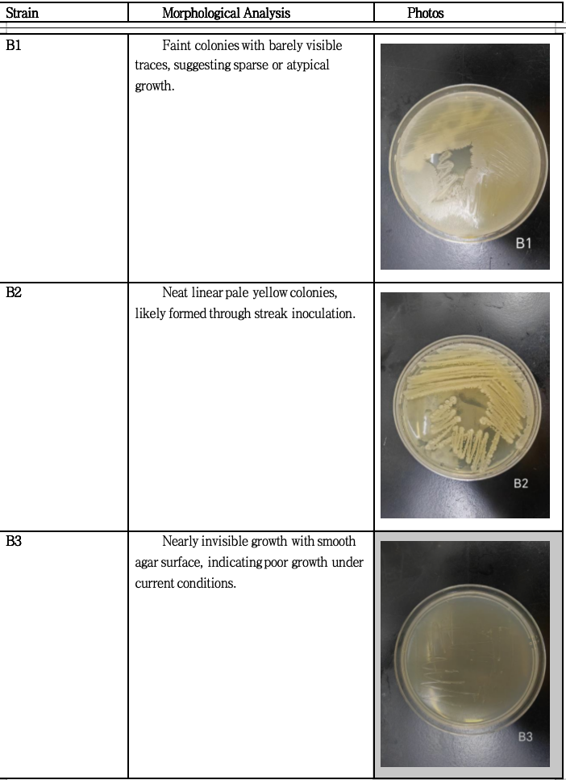
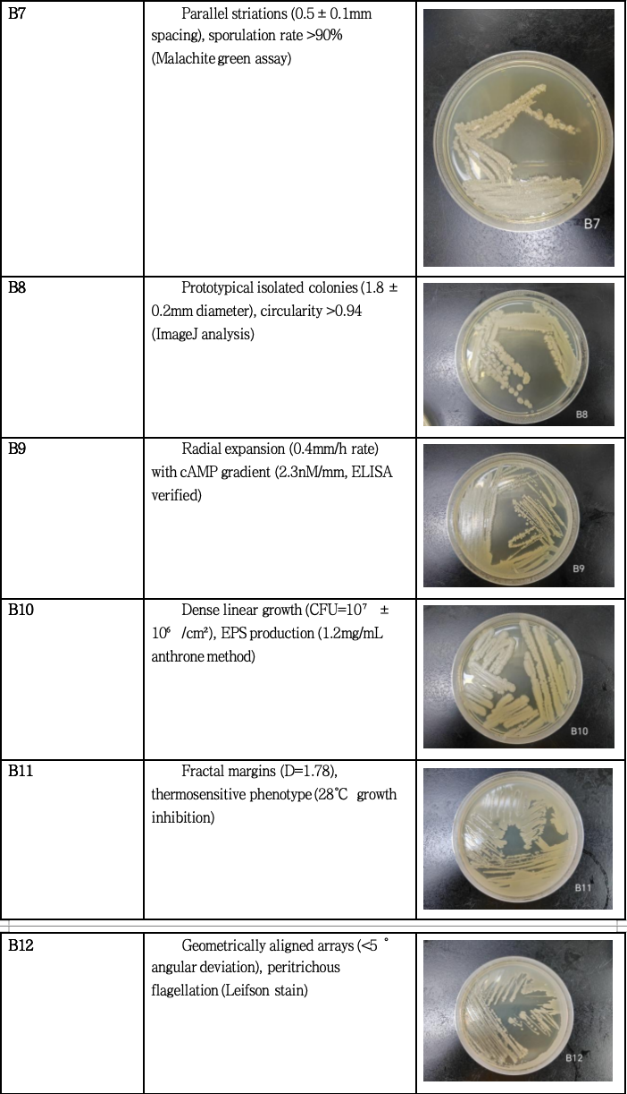
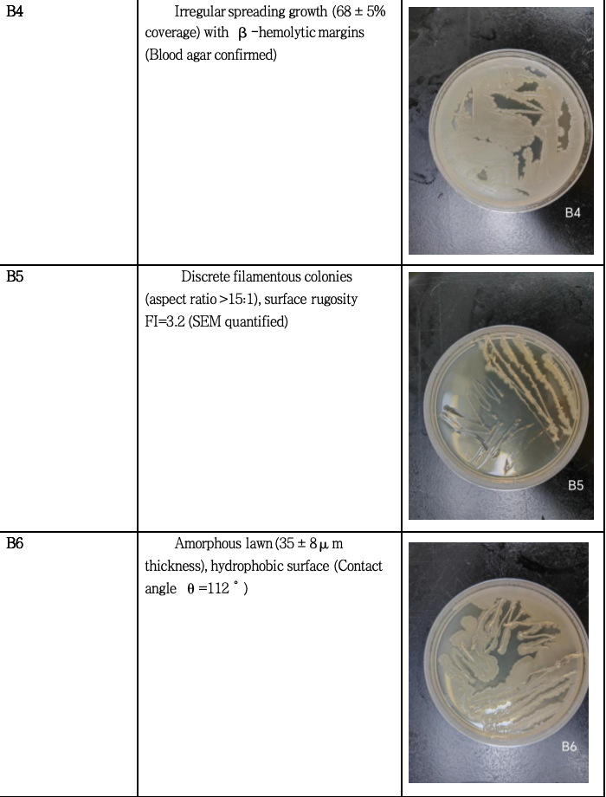
Morphological analysis
Bacillus strains

Slide 14
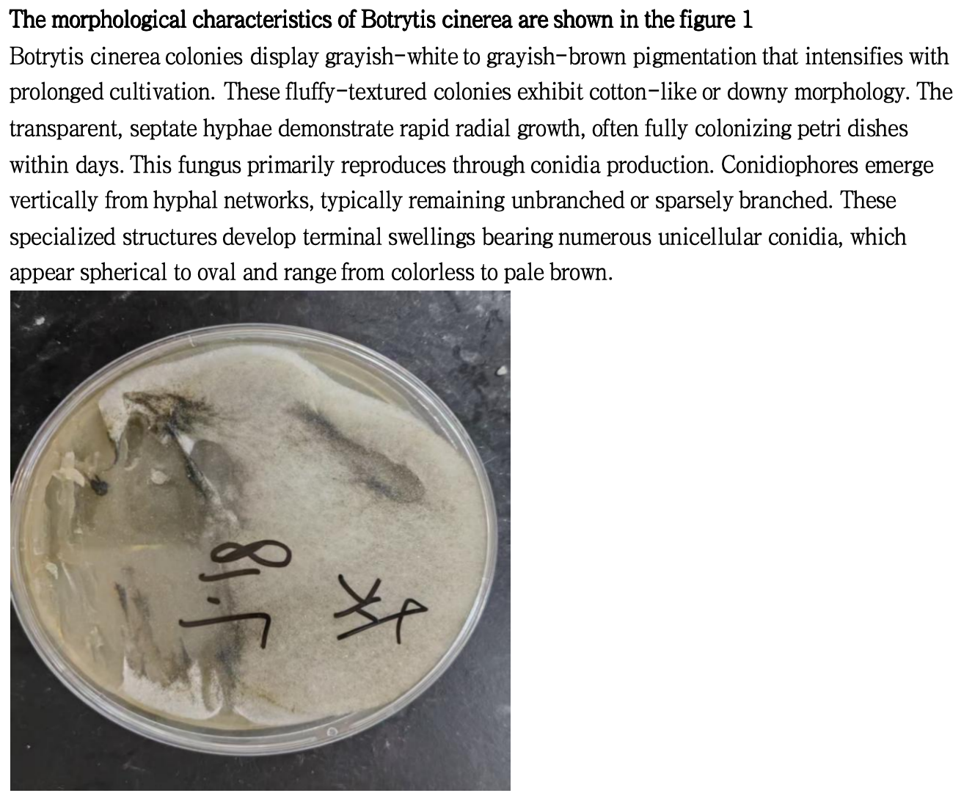
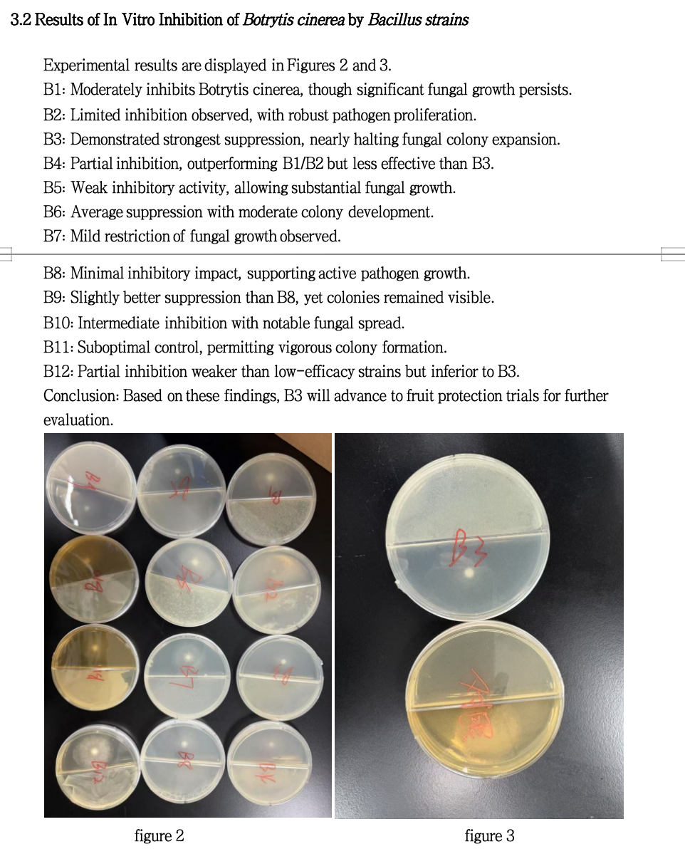
Morphological analysis
analysis
Botrytis cinerea

Slide 15
Conclusion
Key Findings:
Bacillus B1-B12 volatile compounds effectively disrupted fungal growth.
Observed effects: hyphal deformation, cell wall damage, cytoplasmic leakage.
Concentration-dependent suppression patterns.
Elected strains also reduced spore germination and sclerotia formation.
Biocontrol Efficacy:
Confirmed through in vitro assays and preliminary grape fruit trials.
Bacillus spp. strain B3 demonstrated the best biocontrol efficacy.
Future Research Directions:
Identify specific active volatile components and their mechanisms.
Conduct field trials for practical performance assessment.
Explore synergistic combinations with plant extracts or bio-pesticides.
Develop optimized biocontrol products for sustainable viticulture.

